Slide 1
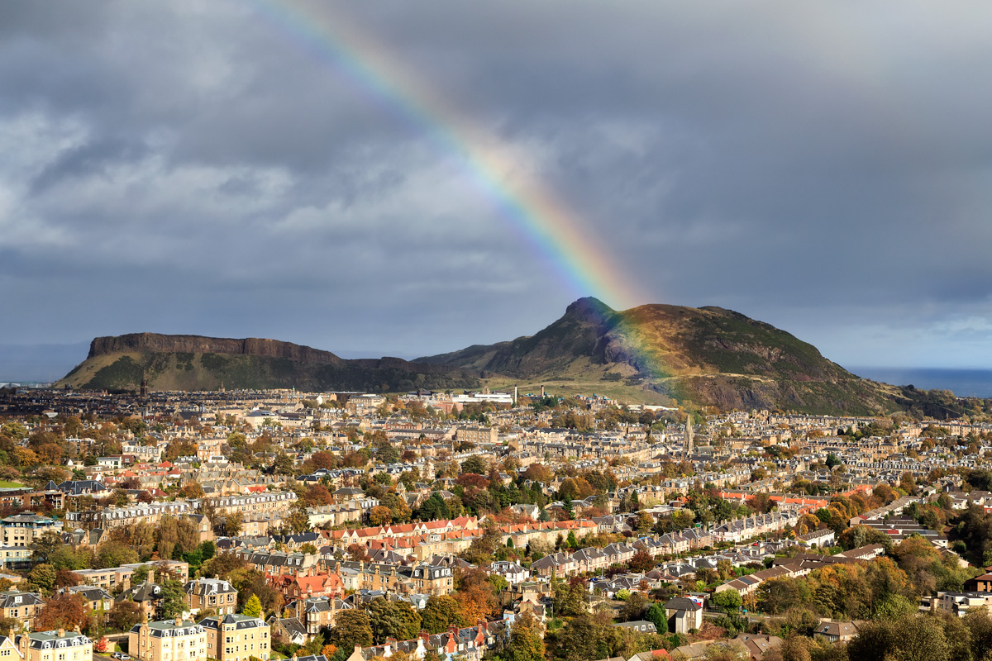
NERC Field Spectroscopy Facility
@NERC_FSF

Slide 2
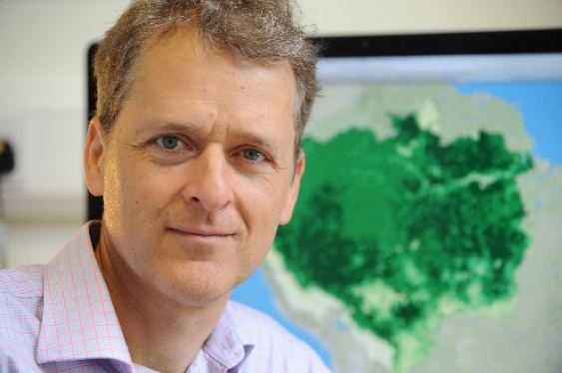
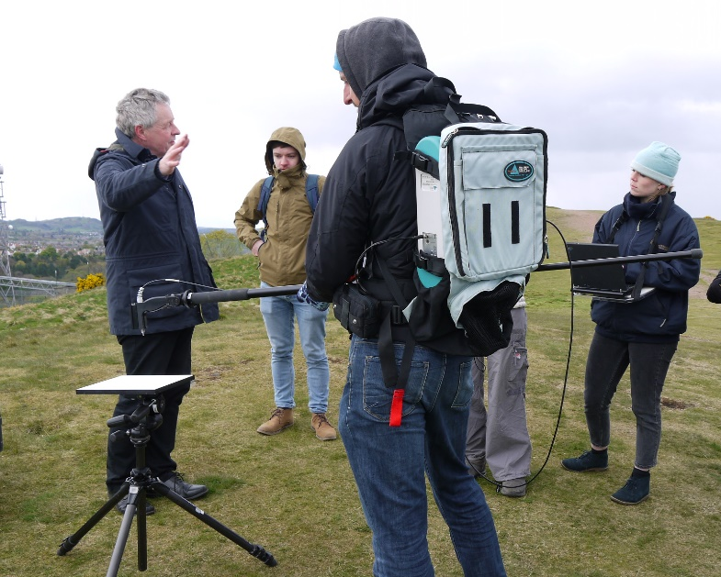
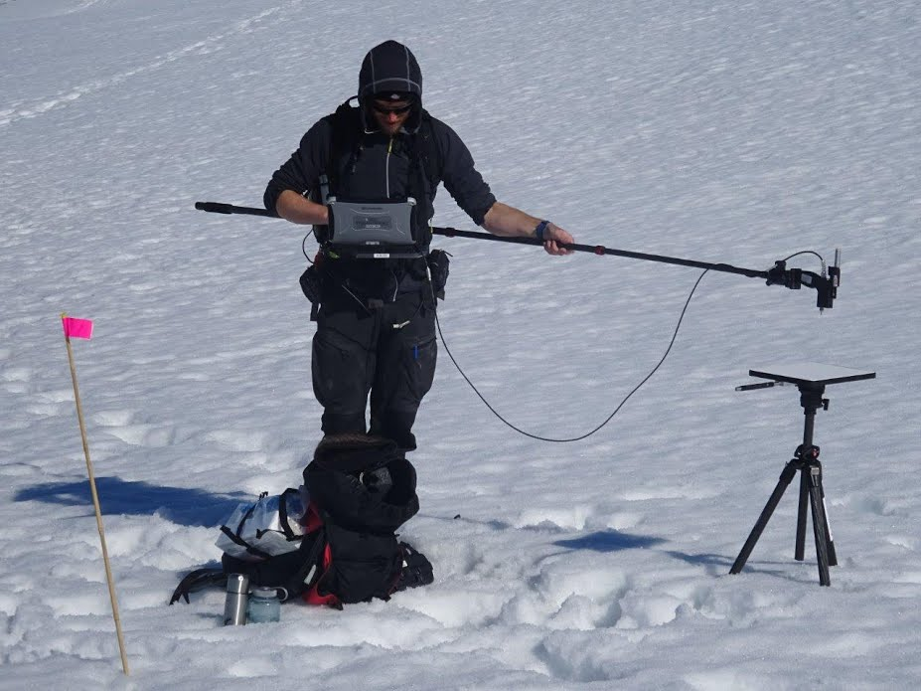
Who We Are…
Prof. Mathew Willaims, Director.
Andrew Gray, Operations Manager
Chris MacLellan, Equipment Manager

Slide 3
The NERC Field Spectroscopy Facility
Host, maintain, calibrate and loan out a pool of field spectroradiometers, sunphotometers and underwater equipment.
Train our users to collect the highest possible quality data for their intended research question.
Calibration/characterisation/inter-comparison capabilities for earth observation sensors. Portable and laboratory.
  E.g. Characterise ARF’s hyperspectral camera.
Develop instrumentation to meet new demands within NERC and NCEO science.

Slide 4
Conceptual model of reflectance for EO:
Hemispherical-Conical Reflectance Factor
Hemispherical-Directional Reflectance Factor
It is often assumed* that the conical reflected component is the same across the field of view of the sensor and so for EO purposes, we simplify this model to HDRF
HCRF
HDRF
Schaepman-Strub (2006)
*incorrectly

Slide 5
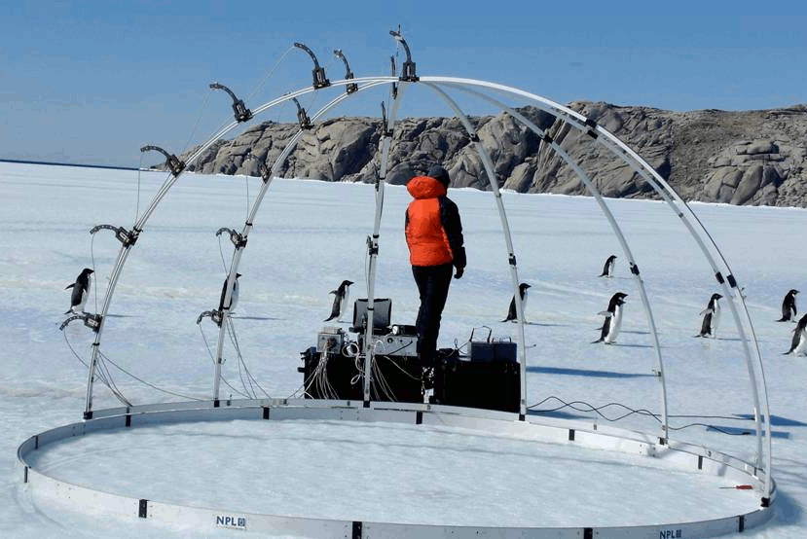
Measuring Reflectance: HDRF
GRASS Gonio Radiometric Spectrometer System
Has been deployed to Antarctica twice
Adjustable zenith and azimuth measurement angles
Fibre optics based, feeding through a multiplexer to a spectroradiometer (400-1,750 nm)
Very rapid measurement (~30min per hemisphere!)
Not very practical for most EO ground validation.

Slide 6
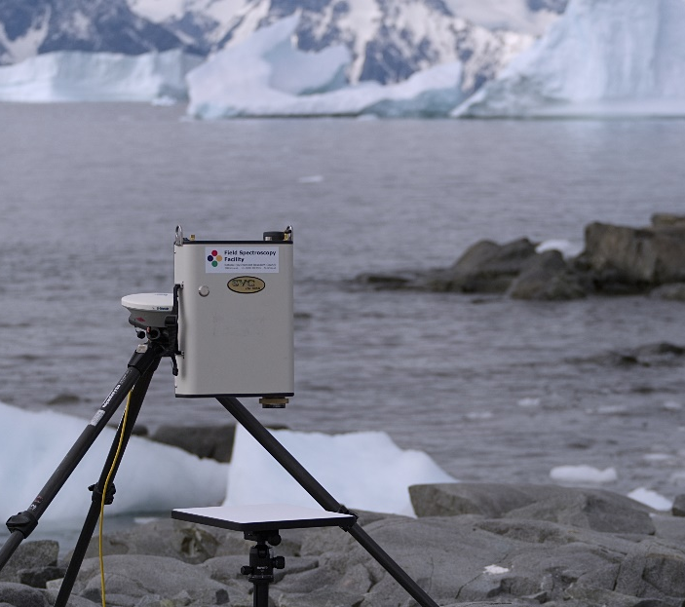
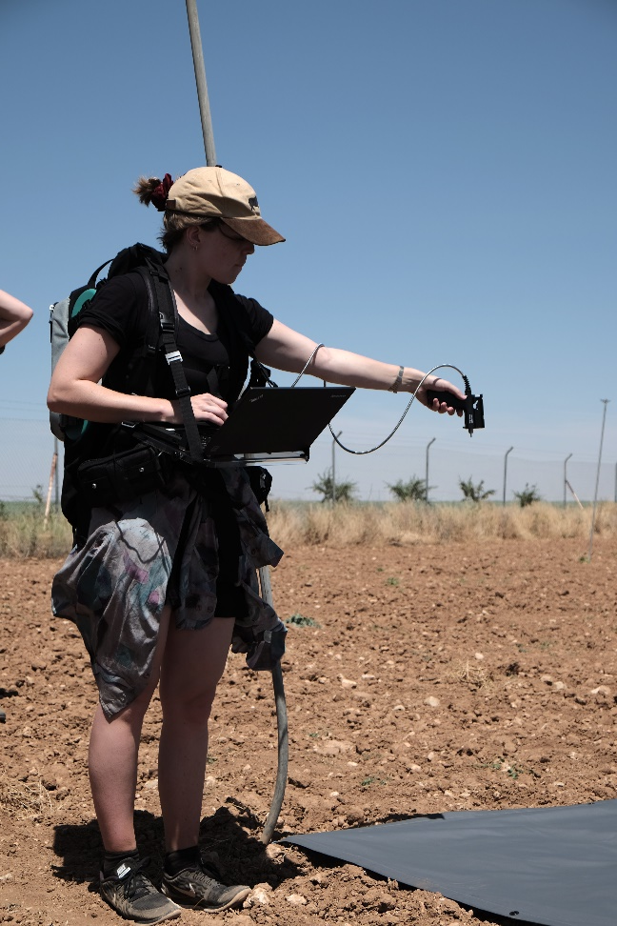
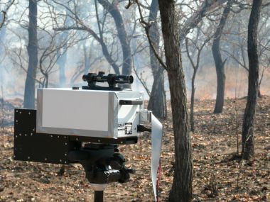
Our Instruments: Spectroradiometers
SVC 1024i
(350 – 2500 nm)
ASD FieldSpec Pro
(350 – 2500 nm)
Midac M4410
FTIR spectrometer

Slide 7
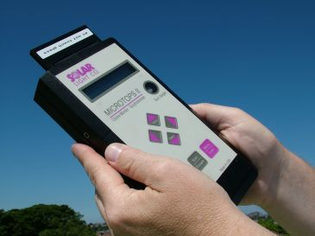
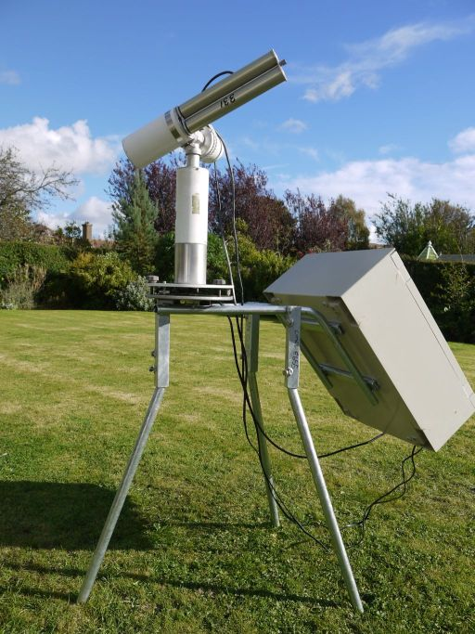
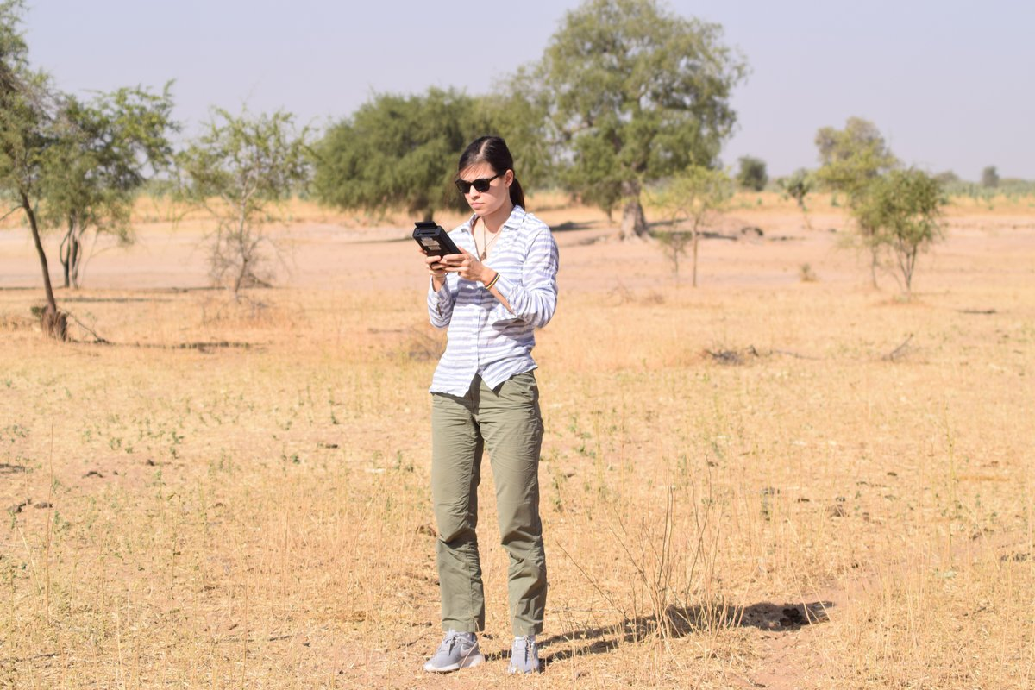
Our Instruments: Sun Photometers
Solar Light Microtops II sun photometers and ozone meters
Cimel CE 318-2 auto-tracking sunphotometer

Slide 8
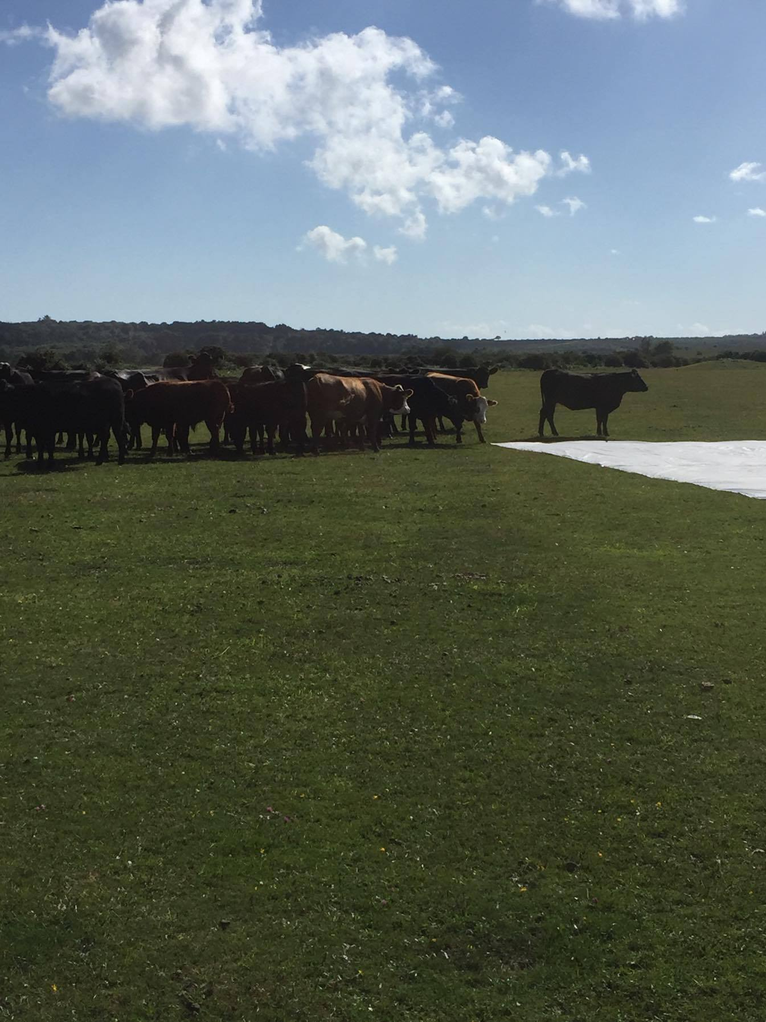
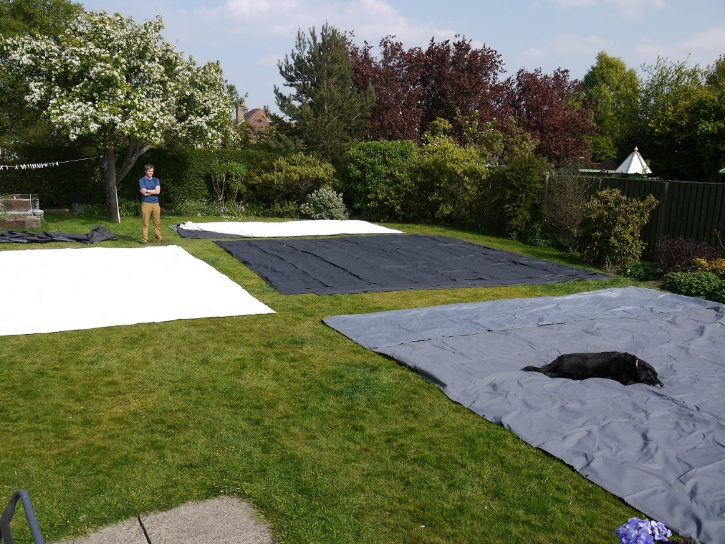
Ground Targets

Slide 9
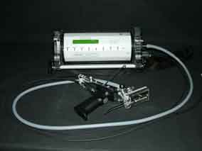
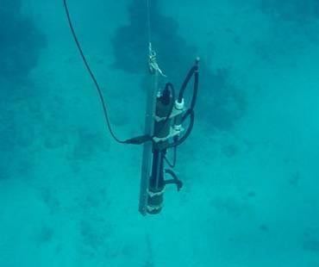
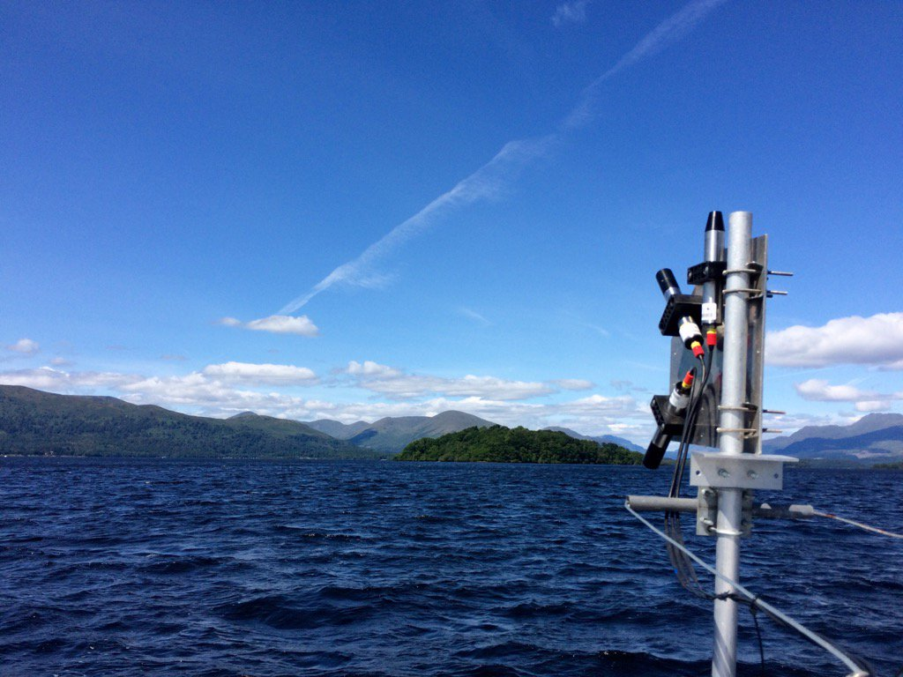
Our Instruments: Underwater
Walz Diving-PAM Underwater Fluorimeter
Wetlabs AC-S underwater hyperspectral absorption
Hyper OCR Hyperspectral Radiometers

Slide 10
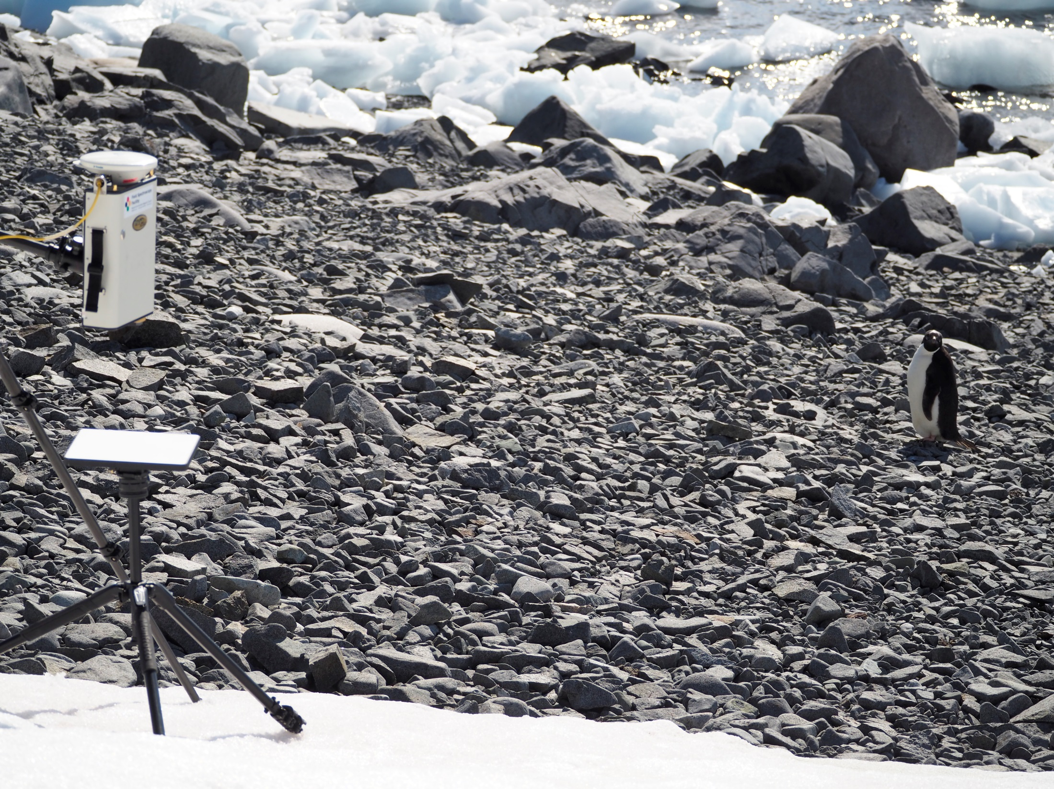
Field Spectroscopy In Research
Field Spectroscopy measures radiance, irradiance, reflectance or transmission properties of vegetation, soil, minerals and water in the natural environment.
Our Users:
  Earth observation
  Plant science and ecology
  Oceanography
  Cryosphere science
  Freshwater ecology
  Geologists/Volcanologists

Slide 11
Field Spectroscopy for Airborne Hyperspectral Surveys
Ground Validation during sensor overflight
Vicarious calibration of images with ground reference targets
Measurements of aerosol optical thickness for inputting into radiative transfer models

Slide 12
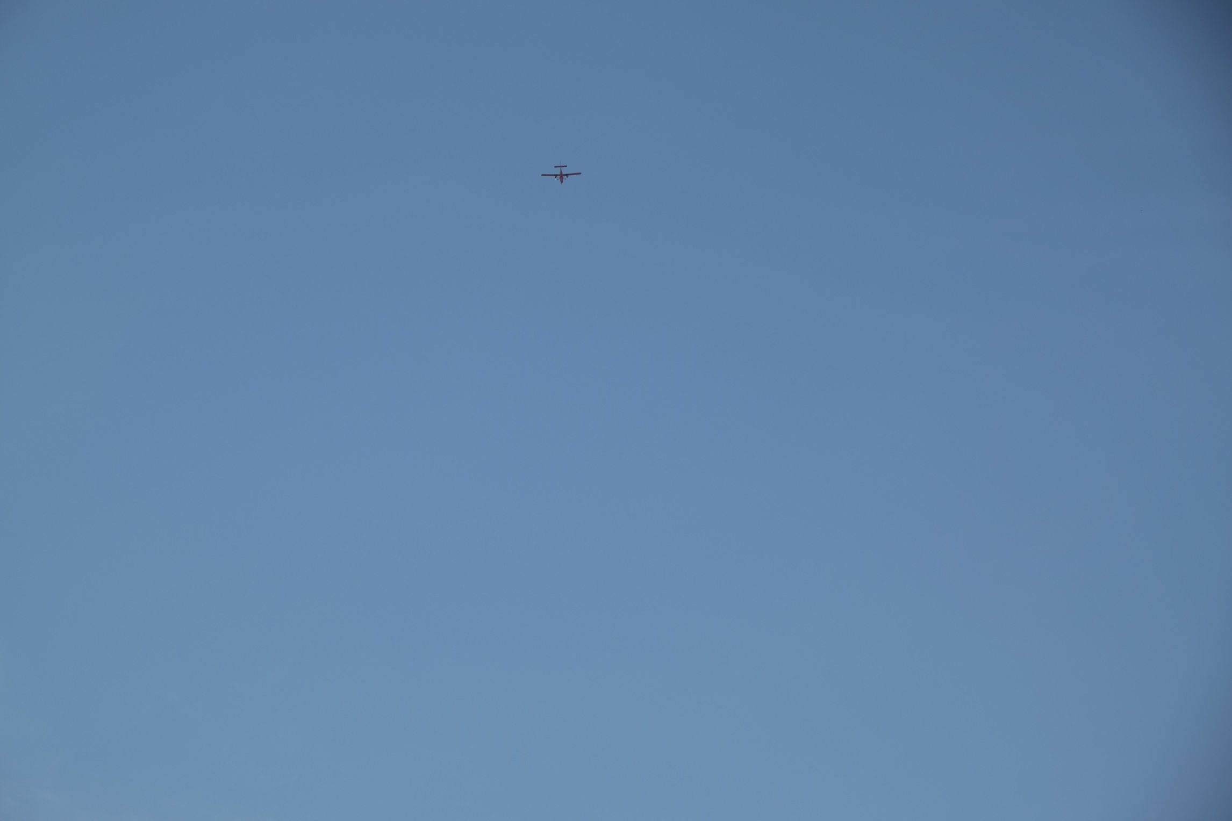
Ground Validation during sensor overflight
Taking measurements in the field during sensor overflight:
Confirms the spectral reflectance of your target (plant/soil/mineral/water/snow) of interest under the same illumination conditions as your image.
Confirms the presence of your target of interest within a pixel.
Calibrates your image to absolute reflectance or units of radiance, allowing comparison between images.

Slide 13
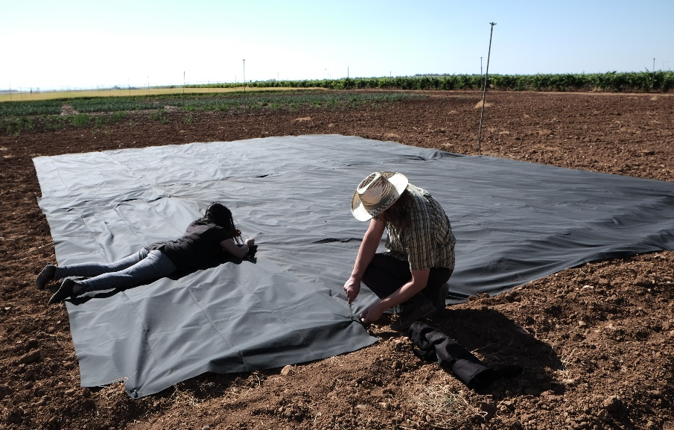
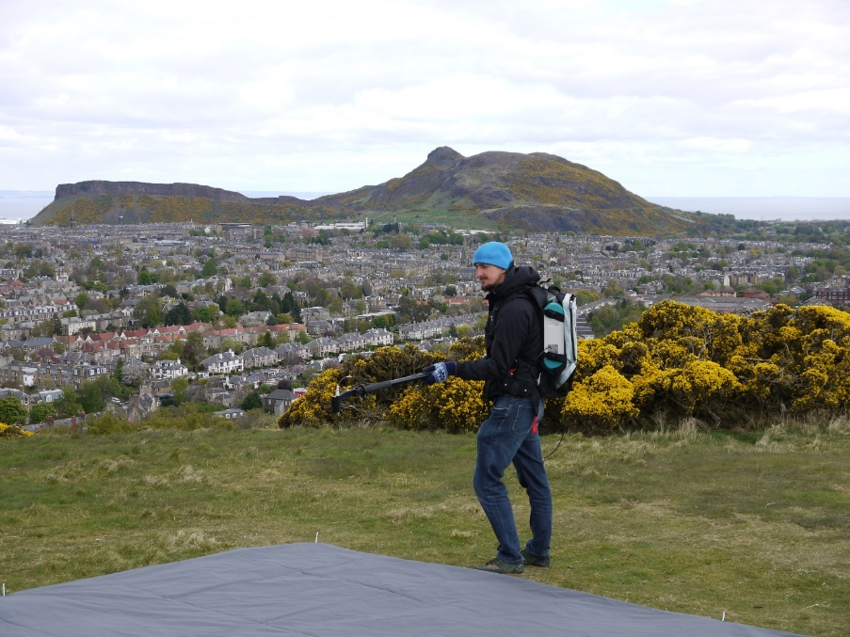
Vicarious calibration of images with ground reference targets: Empirical line method
Setup
3x reflectance calibration points within your image
Measure reflectance during overflight
© Gary Llewellyn, ARF

Slide 14
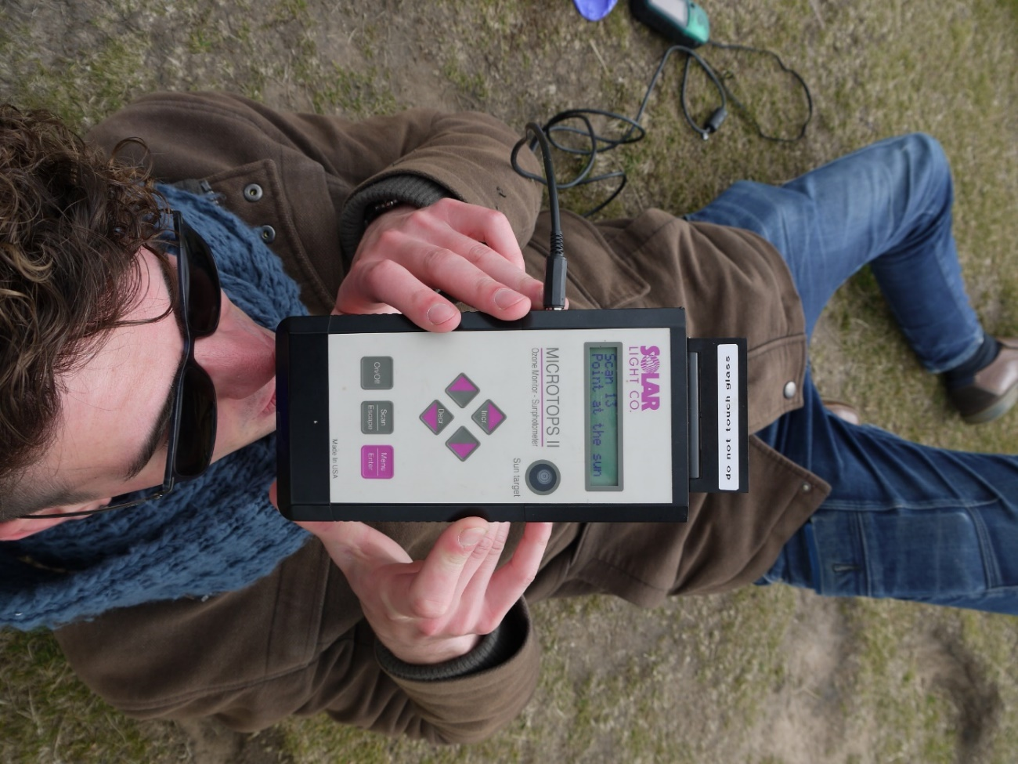
Measurements of aerosol optical thickness for inputting into radiative transfer models
Five filters that correspond to different atmospheric aerosol.
Point them at the sun during overflight to gather information on aerosol optical thickness during image collection.
This information can then be input into radiative transfer models such as 6S and MODTRAN

Slide 15
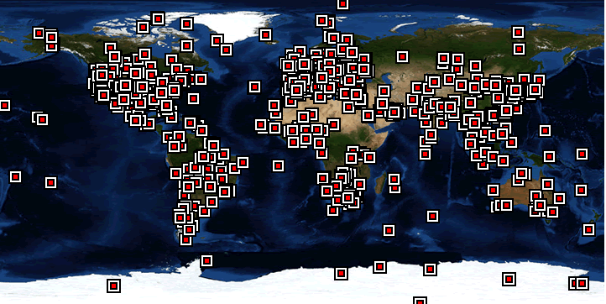
Automatic Tracking Sunphotometer Networks
Networks of constantly tracking sunphotometers provide aerosol optical thickness data at an almost global coverage (great if your flight is near one):
Aeronet (www.aeronet.gsfc.nasa.gov)
ESR (www.euroskyrad.net)

Slide 16
So, how do I get my hands on a spectroradiometer?
http://fsf.nerc.ac.uk/
Application Deadlines:
1st November: Summer Period Applications - Loans from March to September
1st June: Winter Period Applications - Loans from October to February

Slide 17
Our workshop:
30th April – 2nd May 2018
Learn more about field spectroscopy, the equipment, and what you are measuring with it
Get more hands on experience using our instruments and processing data
Gain more understanding in Learn about scaling field data to UAV, airborne and satellite imagery
In Edinburgh!
Free to attend for UK PhD students/academics
To apply email fsf@nerc.ac.uk

