Slide 1
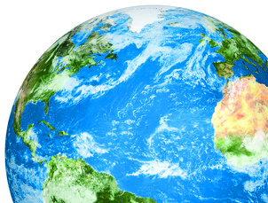
Atmospheric Correction
Dan Clewley, NERC-ARF-DAN
@NERC_ARF_DAN

Slide 2
Atmospheric Correction
Why it is needed
Some methods
Practical considerations

Slide 3
Reflectance data
This is what you would measure in the field
Chris MacLellan, NERC Field Spectroscopy Facility

Slide 4
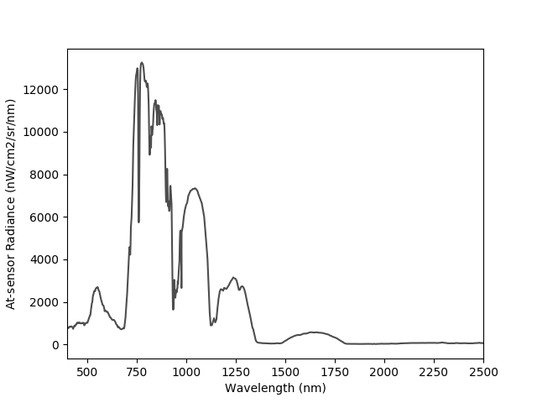
At-sensor radiance data
This is what level 1b / 3b airborne hyperspectral data provides

Slide 5
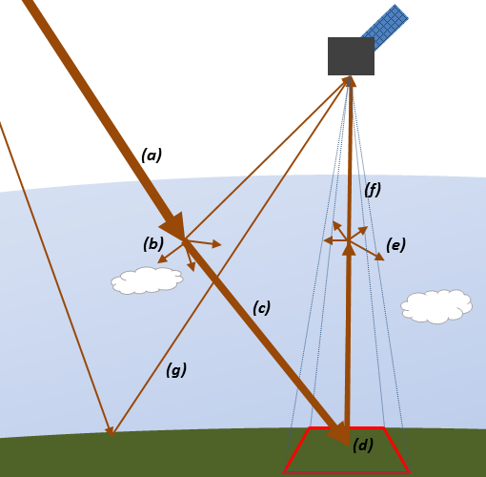
The path of light
Difference between surface reflectance and at-sensor radiance
Variations in solar irradiance (time and location)
Scattering and absorption in atmosphere
Down-welling solar irradiance
Scattering (down-welling)
Absorption (down-welling),
Surface reflectance
Scattering (up-welling),
Absorption (up-welling)
Adjacency effect.

Slide 6
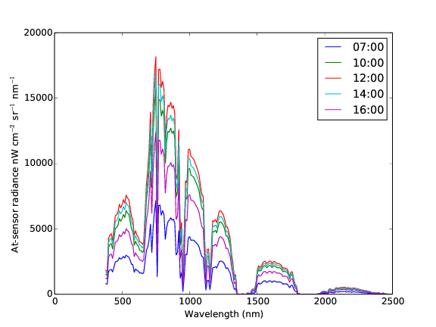
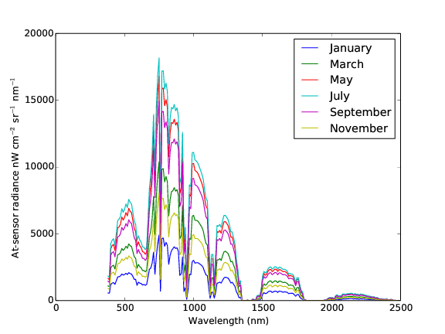
Variation in solar irradiance due to time of year and time of day
Assumes atmospheric conditions don’t change
Notes:
Assume same location (Plymouth, UK) and that reflectance doesn’t change (not looking at phenology)

Slide 7
Atmospheric Correction
Main approaches for airborne
Image-based correction
Normalization to a spectrally flat target (Ben-Dor et al. 1994) or an image average, e.g. dark object extraction / histogram method (Chavez 1996)
Empirical Line Calibration
Radiative Transfer models
Also hybrid approaches

Slide 8
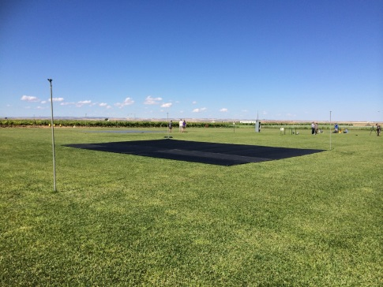
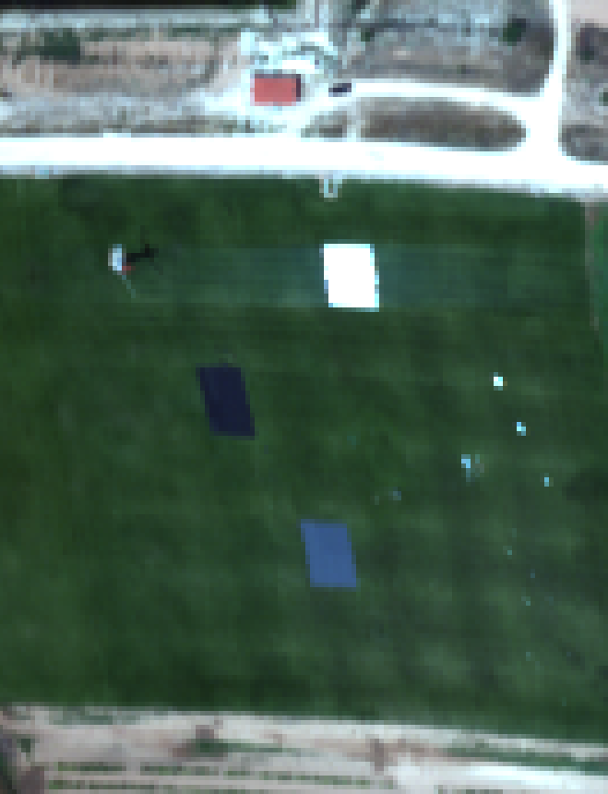
Empirical Line Calibration
Lay out targets or use natural ones
FSF and NERC-ARF have targets available
Large and heavy (not suitable for all locations)
Take spectral readings at time of overpass

Slide 9
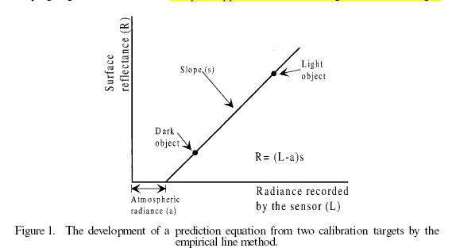
Empirical Line Calibration
Form linear relationship for each band
Apply relationship to all pixels in flight line / flight
Function to do this in ENVI
We have script
Can use corrected orthogonal line to correct other lines in flight
Applies to other correction methods (Asmat, Milton & Atkinson, 2011)
Flow as standard for NERC-ARF data
Smith & Milton 1999
Smith, G. M & Milton, E. J (1999). The use of the empirical line method to calibrate remotely sensed data to reflectance. International Journal of Remote Sensing. Volume 20, Issue 13. pages 2653-2662.
Karpouzli, E & Malthus, T (2003). The empirical line method for the atmospheric correction of IKONOS imagery. International Journal of Remote Sensing. Volume 24, Issue 5. pages 1143-1150.

Slide 10
Empirical Line Calibration - Assumptions
No differences in illumination across the image
changes in radiance due to cloud shadowing or topography would be ignored
The effects of the atmosphere are uniform across the image.
However, atmospheric constituents, especially water vapour, can vary greatly over short distances (Gao et al. 1991). NB: flat terrain.
The Earth’s surface consists of Lambertian reflectors
But most surfaces have bi-directional reflectance properties (Silva 1978).
Areas of homogeneous reflectance
Of sufficient size to account for the Point Spread Function.
Source Gary Llewellyn, NERC-ARF

Slide 11
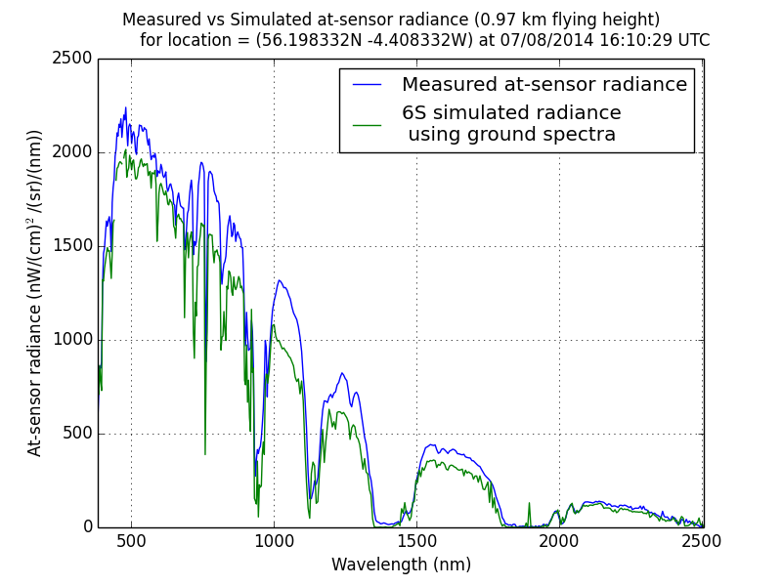
Radiative Transfer (RT) models
Create a model of the atmosphere and use this to estimate absorption and scattering within the atmosphere
Examples are MODTRAN and 6S
Require a number of input parameters:
Aerosol type
Aerosol optical thickness
Water vapour
Will cover in practical session
Example of ground spectra with atmosphere modelled using 6S

Slide 12
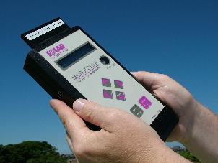
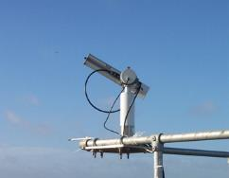
RT modelling - Aerosol optical thickness data
Derive from image data:
ATCOR AOT retrieval based on Dense Dark Vegetation (DDV)
Measure
FSF sun photometer (recommended)
External data
AERONET
Derive from image and validate
Chris MacLellan, NERC Field Spectroscopy Facility
Notes:
Definition
"Aerosol Optical Thickness" is the degree to which aerosols prevent the transmission of light by absorption or scattering of light. The aerosol optical depth or optical thickness (τ) is defined as the integrated extinction coefficient over a vertical column of unit cross section. Extinction coefficient is the fractional depletion of radiance per unit path length (also called attenuation especially in reference to radar frequencies). The optical thickness along the vertical direction is also called normal optical thickness (compared to optical thickness along slant path length).
https://disc.gsfc.nasa.gov/data-holdings/PIP/aerosol_optical_thickness_or_depth.shtml

Slide 13
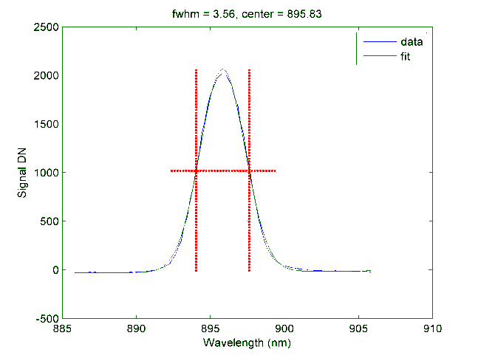
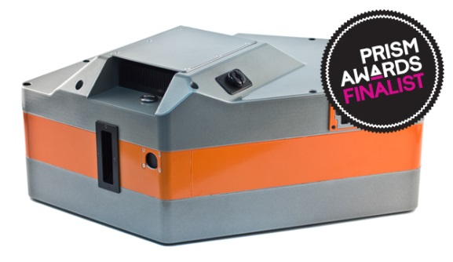
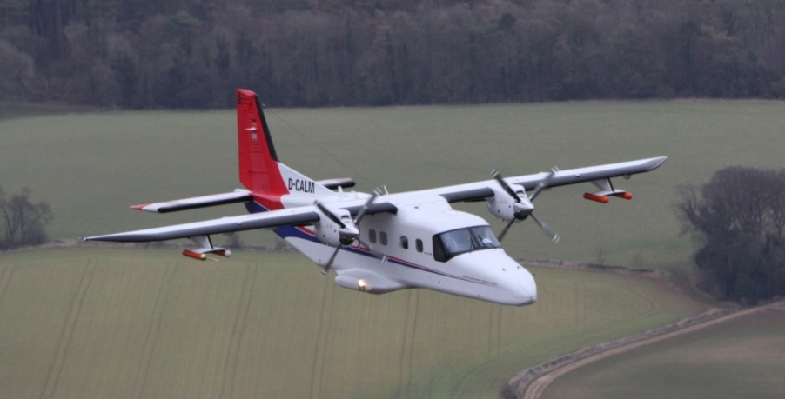
RT modelling – platform and instrument characteristics
Instrument
Range of wavelengths
Centre wavelengths for each band
Response function (approximate with FWHM)
Look angle (pixel dependent)
Platform
Height above ground (also depends on surface)
Flight heading

Slide 14
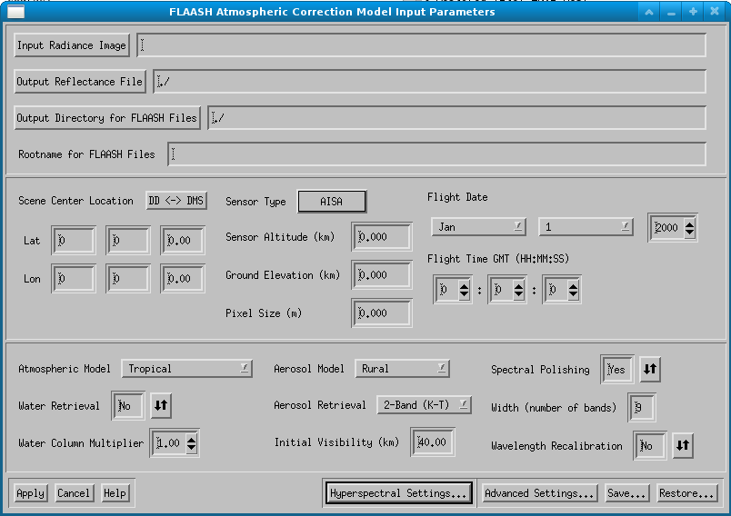
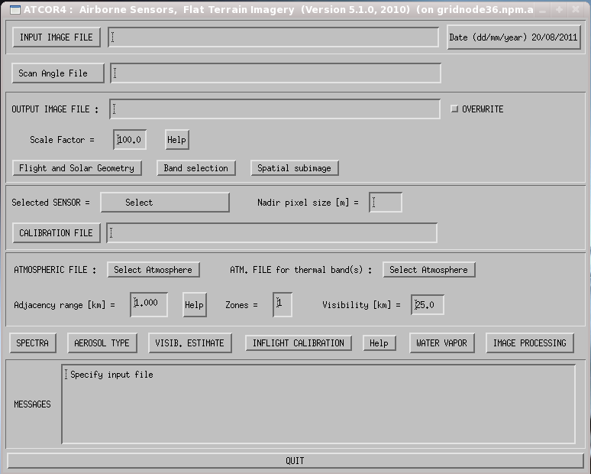
RT-based atmospheric correction packages
A number of software packages can perform atmospheric correction using RT models:
FLAASH (https://www.harrisgeospatial.com/docs/FLAASH.html)
ATCOR4 (http://www.rese.ch/products/atcor/atcor4/)

Slide 15
Atmospheric correction using RT models
Software packages don’t always need ground data
Should aim to collect
Always useful to validate or use in hybrid approaches
In an idea world would parametrise model based on in situ measurements
e.g., AOT from Sun photometer / AERONET
Needs accurate radiometric calibration
See Aser’s Calibration talk

Slide 16
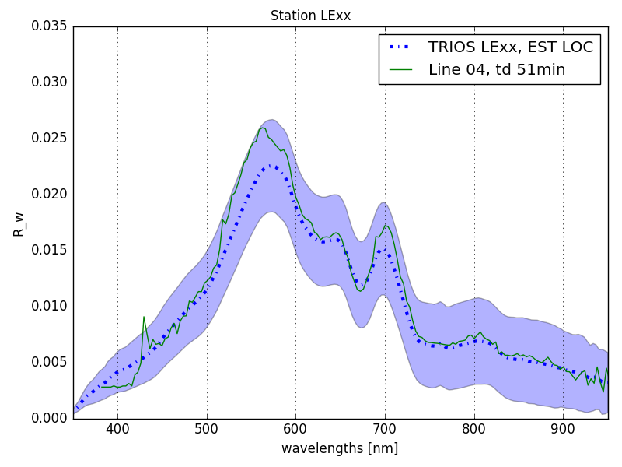
ATCOR-4
ATCOR-4: Atmospheric & Topographic Correction
Based on MODTRAN
Algorithms to automatically derive main atmospheric parameters from the imagery
Options for
In-flight calibration of the sensor using ground reference targets
Interactive shadow compensation
Simple nadir normalization (normalizing the across-track radiance gradients)
Methods for correcting BRDF effects
Atmospherically corrected water spectra compared to in situ data
Markelin, L.; Simis, S.G.H.; Hunter, P.D.; Spyrakos, E.; Tyler, A.N.; Clewley, D.; Groom, S. Atmospheric Correction Performance of Hyperspectral Airborne Imagery over a Small Eutrophic Lake under Changing Cloud Cover. Remote Sens. 2017, 9, 2.

Slide 17
NERC-ARF-DAN Atmospheric Correction Service
Have been developing a procedure for atmospheric correction based on ATCOR4
Driven by requests from users
Building on existing work at PML including satellite and work with other groups
Focus on automation
Offer guidance or provide service
Some users still would rather do correction themselves - have guide and scripts on GitHub (private - email for access)
Can apply at PML for additional cost
Work in progress
Still refining based on best practices, including field support
Input is welcome!
Notes:
Also hybrid approaches which combine RT with empirical line

Slide 18
Best Practices - Prior to the survey
Test the instruments
Both to check that they are working and to give you practice in using them. Ideally attend training courses such as that offered by the Field Spectroscopy Facility (FSF), this is a requirement if you borrow instruments from FSF.
Plan the survey
Identify suitable targets before the survey day.
Do as much planning as possible before the flight
Do a “dry run” if possible
Print off maps (+ spares)
Read scientific papers and guides on the topic
make sure you are collecting what YOU need for YOUR study
Remember the spare batteries
don't get out to the field only to find you have no power.
Remember to take lunch / refreshments with you - it will be a long day!
https://nerc-arf-dan.pml.ac.uk/trac/wiki/Processing/atmosphericcorrection
Notes:
Also hybrid approaches which combine RT with empirical line

Slide 19
At the survey
Do not stand between the sun and the survey point
Measure level, homogeneous targets of greater size (5 - 10 times) than the resolution of the remote sensing data
Make sure you collect more than one observation over the target to improve the measurement statistics (get as many as possible to calculate averages and standard deviations).
Try to measure near the centre of the targets rather than the edge where possible.
Always get an accurate measurement of position (use GNSS / GPS connected to the measurement instrument).
Take photographs
Measure a mixture of targets
Record the sky conditions
Measure the white reference often (every other measurement).
Go on FSF course!
https://nerc-arf-dan.pml.ac.uk/trac/wiki/Processing/atmosphericcorrection
Notes:
Also hybrid approaches which combine RT with empirical line

Slide 20
ATCOR-4 Procedure – pre processing
Apply mask to 1b data
aplmask
Remove bands with no-data (e.g., Fenix crossover point)
drop_nodata_bands.py / ENVI
Spectrally resample (optional – reduces noise but can remove features)
spectral_resample.py / ENVI
Map data (optional)
aplmap
Also need to map sensor look angle
Convert from BIL to BSQ interleave
convert_interleave.py / ENVI
All these steps can be run in batch / on HPC
http://github.com/pmlrsg/nerc-arf-atcor - email for access

Slide 21
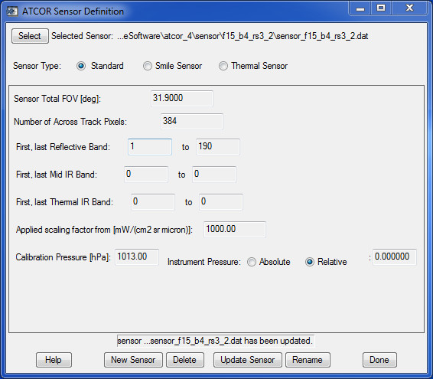
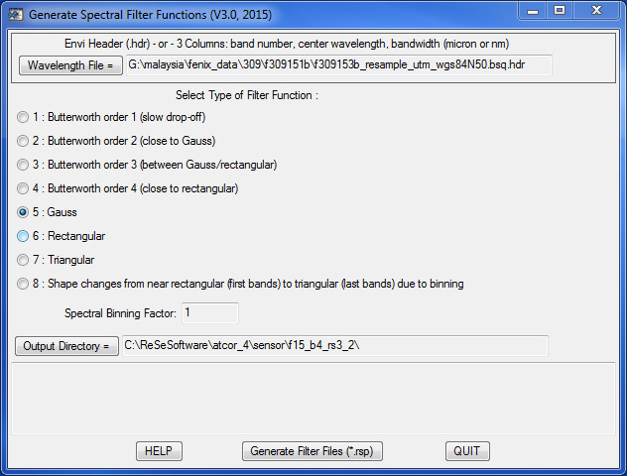
ATCOR-4 Procedure – sensor definition
Define sensor
Specific to sensor
Wavelengths specific to year, binning and any resampling
Define sensor response function
Resample LUT
http://github.com/pmlrsg/nerc-arf-atcor - email for access

Slide 22
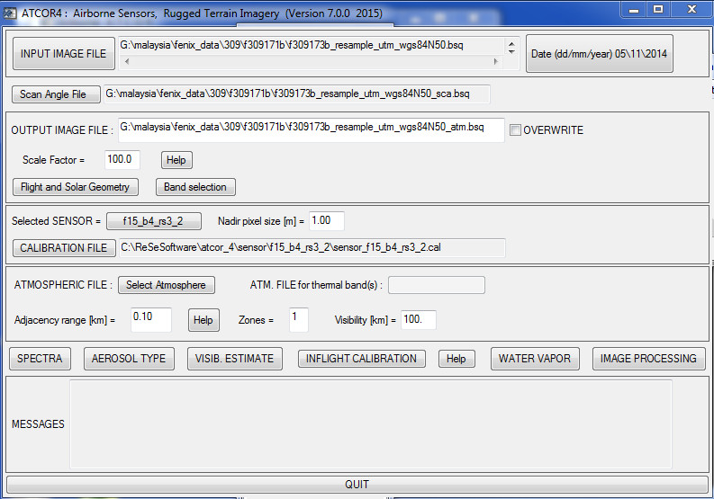
ATCOR-4 Procedure – correction
Most information in log sheet
http://github.com/pmlrsg/nerc-arf-atcor - email for access

Slide 23
Atmospheric Correction Summary
Needs to be applied to compare data
Different days
Airborne vs field
Airborne vs satellite
There are two main approaches to atmospheric correction
Empirical Line Calibration
Radiative Transfer models
+ Hybrids
Need to consider atmospheric correction before the flight so you can plan field data collection
Speak to NERC-ARF and FSF for guidance / additional processing
Not an option when using data from archive
Notes:
Also hybrid approaches which combine RT with empirical line

Slide 24
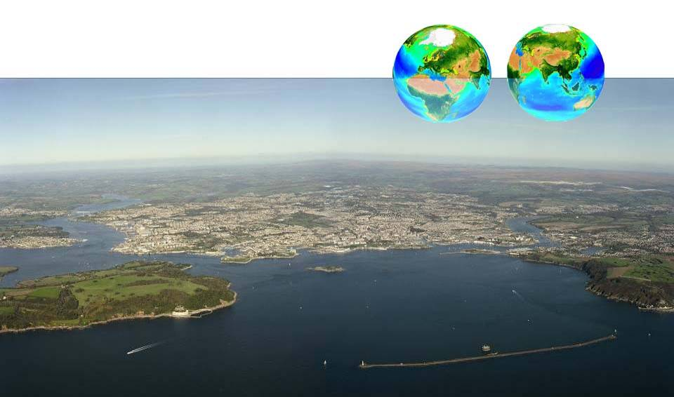
Thank you

